Slide 1
USARC G-1
Military Evaluations
United States Army Reserve Data Management Program

Slide 2
Agenda
Navigating CSMM Evaluations Reports
Updating CSMM Evaluation Comments
Using ERS
Battle Rhythm
Personnel Cross Reference
Questions

Slide 3
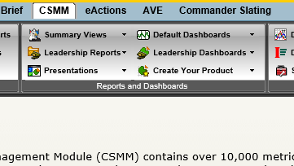
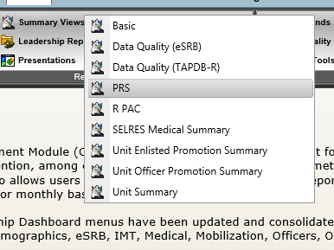
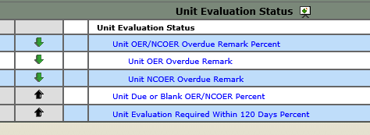
Navigating CSMM
From the CSMM homepage select “Summary Views” then select “Unit Summary” from the pull down menu
On the Unit Summary page, scroll to the bottom to reveal Evaluation statistics for your level of command

Slide 4
Navigating CSMM (cont.)
From this page the user can click and drill down to the by name report of overdue evaluations
Total of all OER/NCOER overdue
Total of all OER overdue
Total of all NCOER overdue
Total of OER/NCOER Due based on user input via Unit Management, Remarks, and Blank Remarks
Total of Evaluations Coming due within 120 days based on TABDB-R data and user input from Unit Management, Remarks
The Focus of this presentation is accurately updating the remarks for evaluations in the Unit Management tool in order to provide an accurate picture of evaluation status’

Slide 5
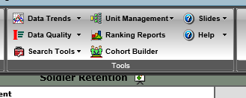
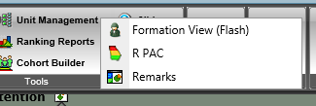
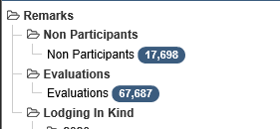
Updating CSMM Remarks
Navigating to Remarks Section
In the Tools menu from CSMM click on Unit Management
From the subsequent pulldown menu select “Remarks” at this point the page will refresh into the Remarks Management Center
Lastly click on “Evaluations” which will pull evaluation remarks for all Soldiers in the hierarchy for which the user has access permissions.

Slide 6
Updating CSMM Remarks
When to make remarks
When an evaluation remark is blank (Code 1A, 2A, 9A, 9H, 9Q)
After transition many times the existing remark is cleared, it is incumbent on the gaining organization to identify the SM’s evaluation requirements and accurately code them in CSMM, Unit Management, Remarks appropriately
When a Soldier is newly promoted to SGT-E5 (Code 9P), 2LT-O1 (Code 9F), WO1-W1 (Code 9G)
When the rated Soldier is required to receive an Extended Annual Report, During a period of “Authorized” Non-Participation, Assigned not joined, or other as required due to significant issues which are not covered under other codes (Code 9Q),
When an evaluation has been “Submitted to HQDA” verifiable through the use of the Evaluation Reporting System (ERS)

Slide 7
Updating CSMM Remarks
Coding accurately
1A – The majority of evaluations that are blank belong in this category, this code means the Soldier has been assigned to the current organization long enough to be rendered an evaluation from the current rating scheme.
2A – Once a Soldier transfers from one USAR organization to another USAR Organization, if an evaluation has not been rendered by the previous command the gaining command should code the SM as 2A and maintain frequent contact with the losing command to acquire an evaluation.
4A – Once an evaluation has been Submitted to HQDA by the Senior Rater or delegate, the SM remark should be coded 4A, if returned then the code should be changed back to 1A until corrections have been made
9A – Once a Soldier has transferred from the IRR (only within the first 16 months of the transfer)
9F – Upon Appointment as an Officer (only within the first 16 months of the appointment)
9G – Upon Appointment as a Warrant Officer (only within the first 16 months of the appointment

Slide 8
Updating CSMM Remarks
Coding accurately
9H – Date of reappointment within the past 16 months, this would apply to an AC/ARNG NCO, Officer, or Warrant Officer who transitioned via conditional release or direct accession to the USAR from another component.
9P – Date promoted to SGT within past 16 months, the remarks section will default to blank, and RLAS will report to TABDB-R blank data, the date of promotion is considered the previous evaluation date in RLAS, while coding of 9P should be used in CSMM Remarks.
9Q – Date for Extended Annual, anytime an AER covers a period of time between evaluations, or when other criteria are met which warrant an extended annual report are met IAW AR 623-3
Period of Non-Participation, many Soldiers in the USAR take authorized periods of Non-participation, the SM is still required to receive an evaluation which covers the entirety of their career. Periods of Unsatisfactory Participation do not render time for an evauluation, and the start date of the next evaluation will be the date of recovery
Assigned not joined, this applies when a Soldier is mobilized under one command and is subsequently assigned to a different command prior to the end of the mobilization
Other, examples could include when a Soldier is under the care of a medical provider, etc.

Slide 9
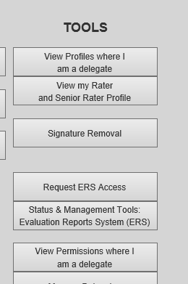
Using the ERS
First time users of ERS will need to request access by clicking the “Request ERS Access” button at “https://evaluations.hrc.army.mil”
Once access is granted click on the link to be routed to the ERS hompage

Slide 10
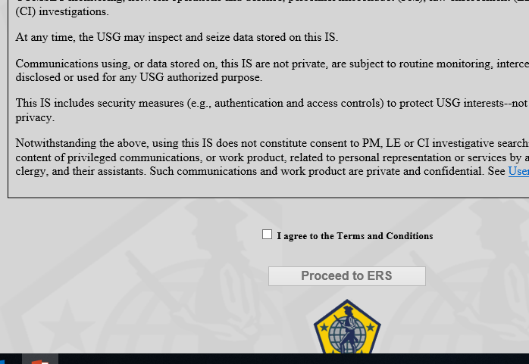
Using the ERS
Select radio button
Click proceed to ERS

Slide 11
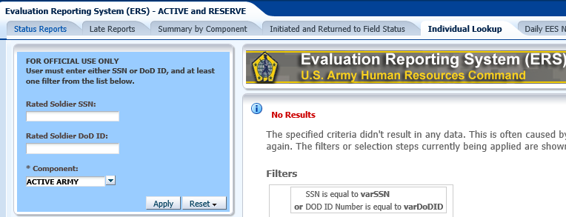
Using the ERS
On the subsequent page click “open on any of the 5 available dashboards
For the majority of evaluations using the individual lookup tool will work best
Input the Soldiers SSN or DODID and select the Component pulldown, ensure Army Reserve is selected, DOD ID numbers can be found using “personnel cross reference” in RLAS

Slide 12
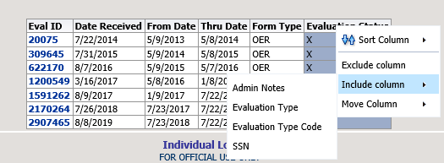
Using the ERS
Right click the header bar
Hover over include column
Click on “Admin Notes”
After the screen refreshes, the admin notes column will be included providing details about the status of the evaluation”
The default sort should render results in order by “Thru Date”

Slide 13
Using the ERS
Take the data found on the most recent OER and return to CSMM, Unit Management, Remarks, Evaluations to make your input based on the system of record data
ERS has other functionality which can be useful for the end user
Status Report – can pull all evaluations produced by UIC for a time period, or all evaluations for an individual giving the Senior Raters name, or all evaluations produced by a Senior Rater for a date range.
Initiated and Returned to Field Status – provides the HR professional the ability to find all evaluations which are returned for correction without the requirement of being included in the rating chain or delegate of the rating chain, providing the rater, senior rater, and if applicable the intermediate or supplementary reviewers name. This report can be generated by UIC, rated Soldier SSN or DODID, or Senior Rater SSN or DODID.

Slide 14
Battle Rhythm
Due to the simplicity of the report generation and input, weekly integration to the battle rhythm should provide enough oversight to maintain accuracy
Senior Raters or delegates should input coding or email their respective HR professional when an evaluation has been submitted to HQDA for update to Remarks
No blanks should exist, all evaluations regardless of circumstance are a result of one of the option codes in CSMM

Slide 15
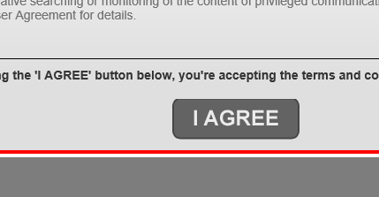
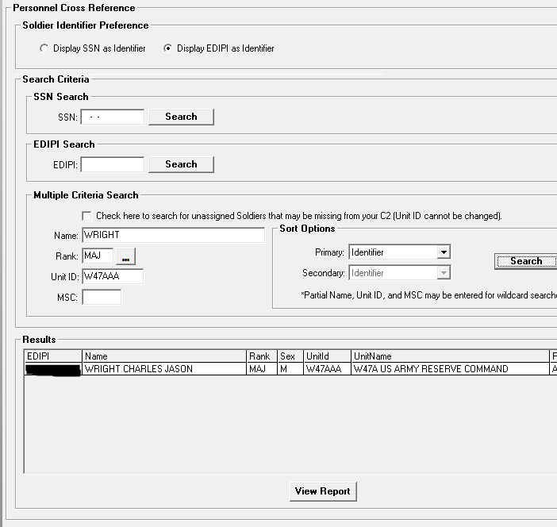
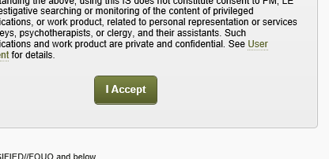
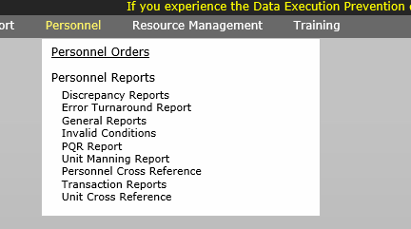
Using PCR in RLAS
Proceed to https://rlas8
Select SSN or EDIPI-(DODID)
Enter as much data as needed to identify the SM accurately
Hover mouse over personnel, and select Personnel Cross Reference
Displays DODID of individual searched for use in ERS

Slide 16
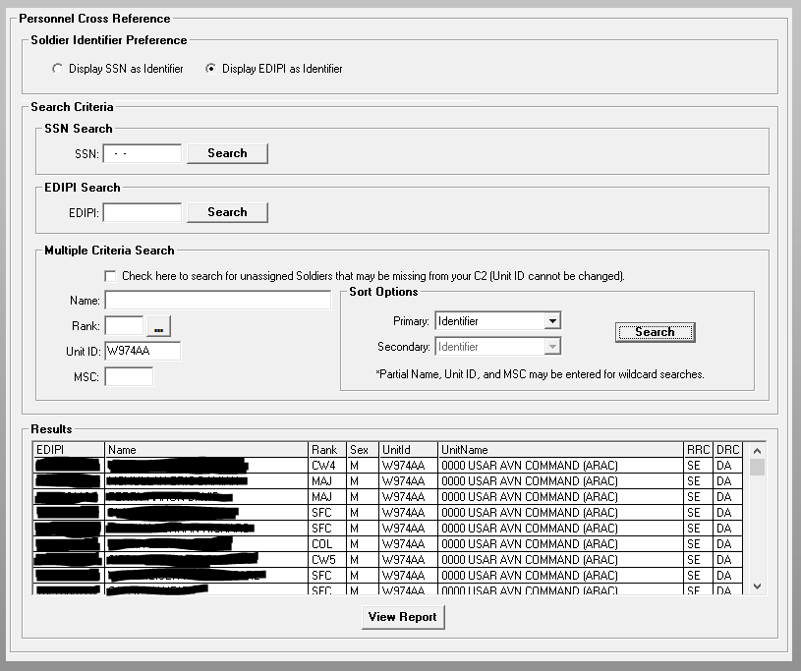
Using PCR in RLAS
Running the report by UIC provides the entire organization EDIPI (DODID)
Can be exported to PDF for ease of use
Anyone with access to RLAS Personnel Cross Reference has the ability to run these reports on any Soldier in the USAR who has an RLAS profile
Provides functionality for other programs that run exclusively on DODID# (unit UPL)

Slide 17
Questions
Charles.j.wright46.mil@mail.mil

